Slide 1


Project Presentation Mobile Application for AICTE
KIET Group of Institutions, Ghaziabad
(An ISO – 9001: 2008 Certified & ‘A+’ Grade accredited Institution by NAAC)
Guide Name: Mr. Amit K. Sanger
Project Members
Gauri Chugh, 2100290120081
Dhruv Gajwani, 2100290120072

Slide 2
Problem Statement
The AICTE website contains extensive data on approved institutions, government schemes, and regulations in various fields.
Accessing this information on the website can be difficult due to its complexity.
A mobile app is proposed to simplify access to key information for stakeholders.
The app will centralize critical resources and improve the user experience.
It aims to provide quick access to frequently needed information while boosting user engagement and compliance.

Slide 3
Solution – AICTE App
A Dedicated Mobile Platform
Curated Statistical Dashboard
Streamlined Access to Initiatives & Schemes
Centralized Resource Hub
Enhanced Transparency & Engagement

Slide 4
Outcomes
Enhanced Information Accessibility
Improved User Experience
Increased Awareness
Streamlined Resource Access

Slide 5
Alignment with UN Sustainable Development Goals (SDGs)
SDG 4: Quality Education
SDG 9: Industry, Innovation, Infrastructure
Enhanced Access to Educational Information
Support for Skill Development
Centralized Educational Resource Hub
Innovation in Information Access
SDG 16: Strong Institutions
SDG 17: Partnerships for the goals
Transparency in Educational Governance
Improved Accountability
Collaboration Between Institutions and Stakeholders
Support for Policy Implementation

Slide 6
Technology Used
Programming Languages: Kotlin, XML
Development Environment: Android Studio
Framework: MPAndroidChart, Android XML Layouts
User Interface: Figma, XML
Database: AICTE Power BI dashboard, Firebase

Slide 7
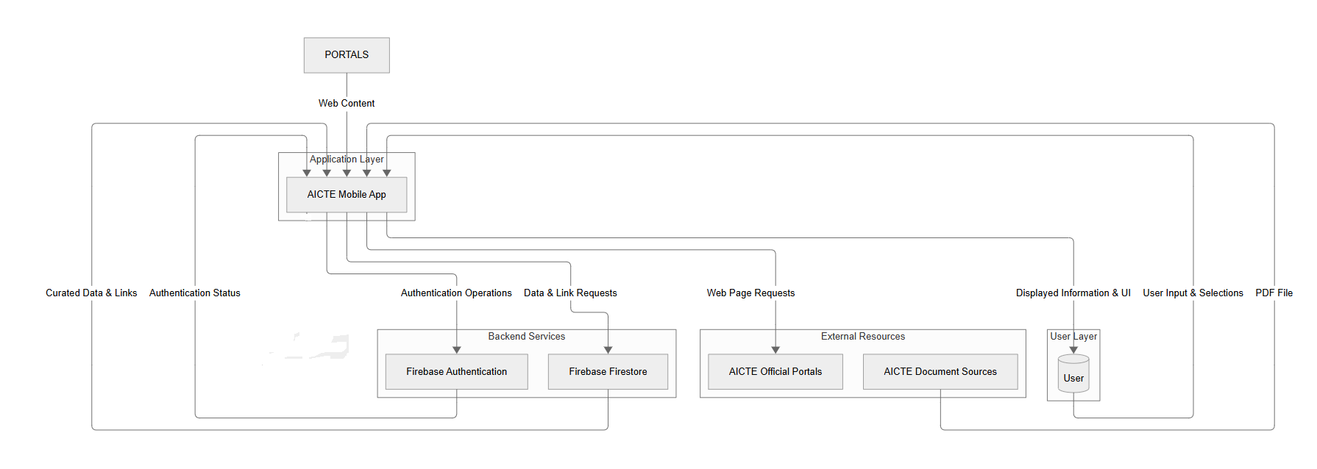
Dataflow Diagram

Slide 8
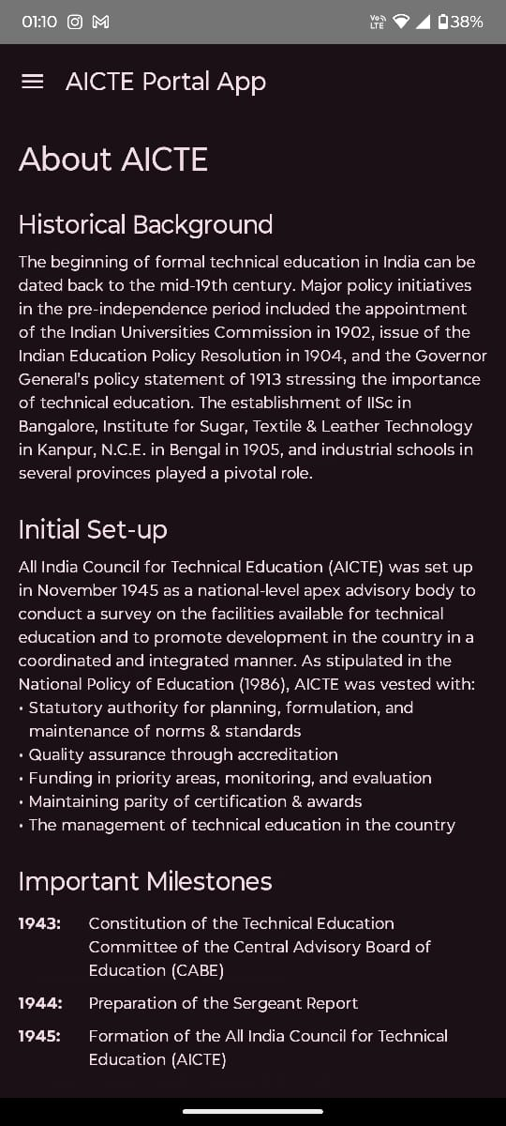
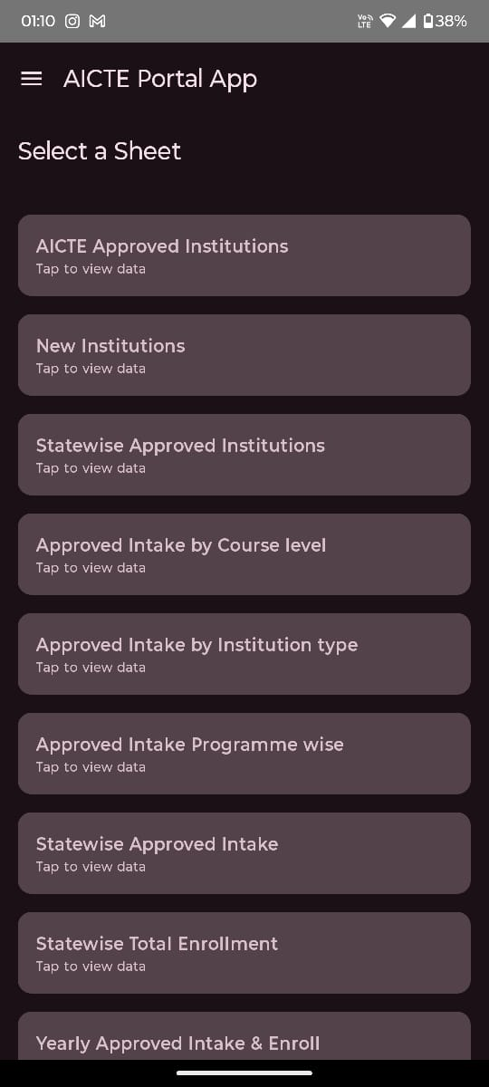
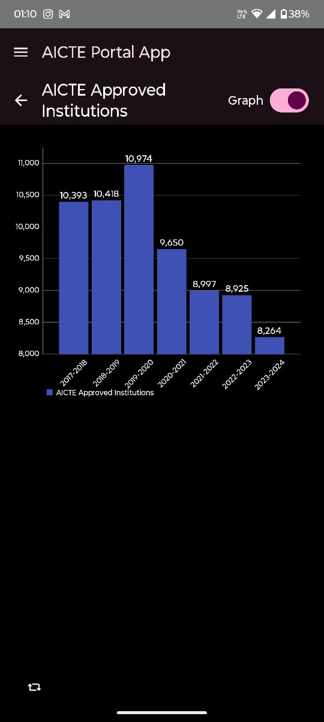
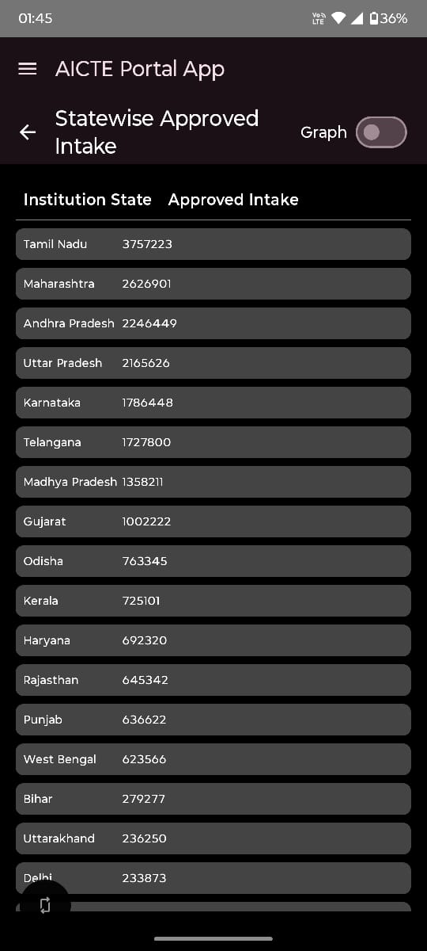
Screenshots of Working Project

Slide 9
Future Scope
Real-time API Integration – With AICTE official Power BI Dashboards
Multi-Language Support
Predictive Analytics
Offline Access

Slide 10
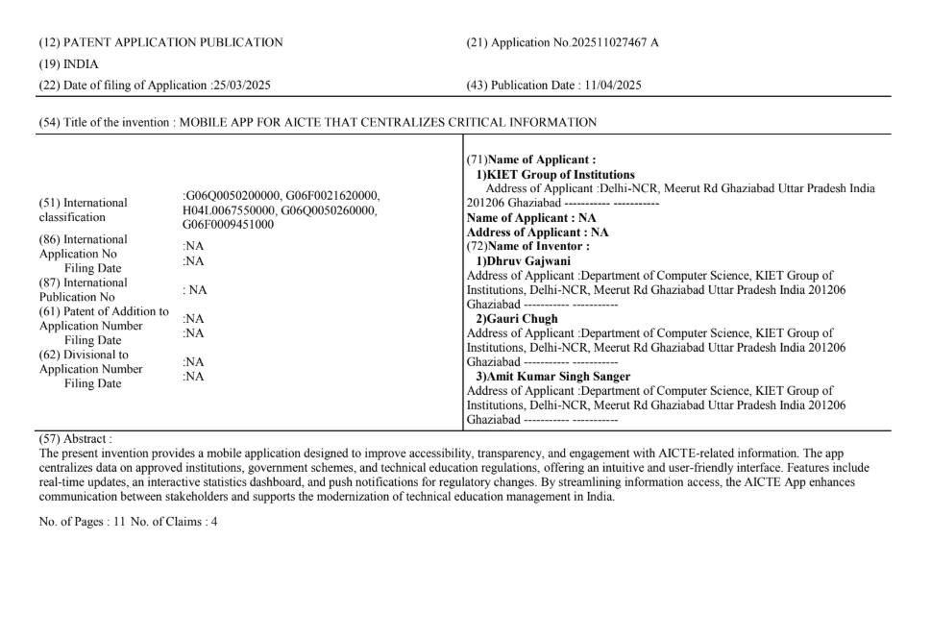
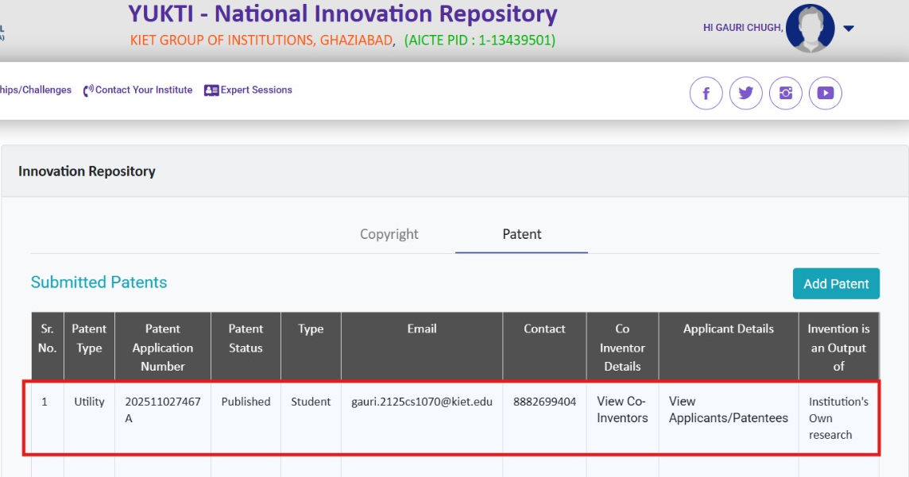
Patent Status on Yukti Portal

Slide 11
References
Gazzawe, Foziah. (2017). Comparison of Websites and Mobile Applications for E-learning.
H. M. Naveen, " AICTE Initiatives for Quality Enhancement in Technical Education, International Journal of Scientific Research in Science and Technology(IJSRST), Online ISSN : 2395-602X, Print ISSN : 2395-6011, Volume 8, Issue 4, pp.382-390, July-August-2021.
Frank, Edwin & Oluwaseyi, Joseph & Olaoye, Godwin. (2024). Introduction to Business Intelligence (BI) and data extraction.
Suhas Holla, Mahima M Katti."Android Based Mobile Application Development And Its Security "International Journal of Computer Trends and Technology (IJCTT),V3(3):1077-1080 Issue 2012
Ehsan, A.; Abuhaliqa, M.A.M.E.; Catal, C.; Mishra, D. RESTful API Testing Methodologies: Rationale, Challenges, and Solution Directions. Appl. Sci. 2022, 12, 4369. https://doi.org/10.3390/ app12094369

